Slide 1



Group Presentation Ethical Hacking (CYT 130)
Team Members
Ishan Patel (146151238)
Umut Yorulmaz (130206238) Kheelesh Krishna Tupsy (164071235)

Slide 2
Statistics
Critical
1
Severe
1
Moderate
2
Low
1

Slide 3
Vulnerabilities
No | Severity | Vulnerability
1 | Low | VNC (Port – 5900/tcp)
2 | Severe | SSH (Port – 22/tcp)
3 | Critical | Distcc (Privilege Escalation)
4 | Critical | SQL Injection - DVWA
5 | Moderate | Cross Site Scripting (XSS) - DVWA
6 | Moderate | Cross Site Request Forgery (CSRF) - DVWA

Slide 4
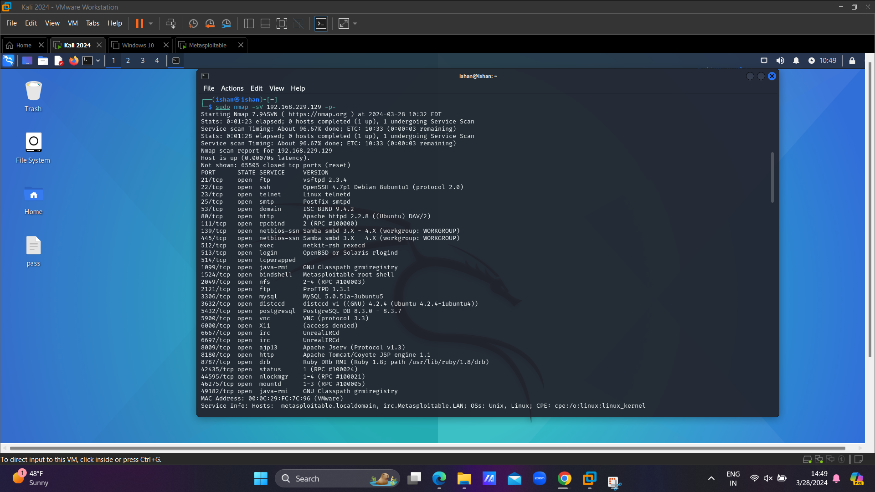
1) VNC – Initial Foothold
VNC is a popular system that allows one computer to take full control of another computer remotely. Vulnerabilities in VNC often stem from insufficient authentication mechanisms, lack of encryption for data transmissions, and the use of default settings such as default passwords or unaltered port numbers. Attackers can exploit these weaknesses to gain unauthorized remote access to the system, observe or manipulate sessions, or use the VNC server as a launchpad for deeper network penetration.

Slide 5
Steps to Exploit
Step 1 – Found the open port 5900 (service - vnc) through nmap.
Step 2 – Use Metasploit to exploit the open port.
Step 3 – We used vnc_login scanner present in Metasploit.
Step 4 – Set all the Parameters (RHOST)
Step 5 – Exploit
Step 6 – Open vncviewer in another terminal with target IP
Step 7 - Boom!! You got the access after typing the password.

Slide 6
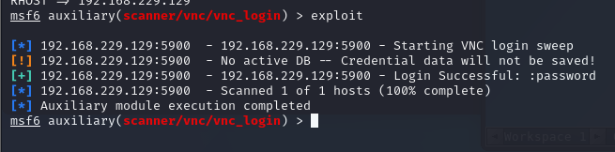
Observation
Focus on line 3

Slide 7
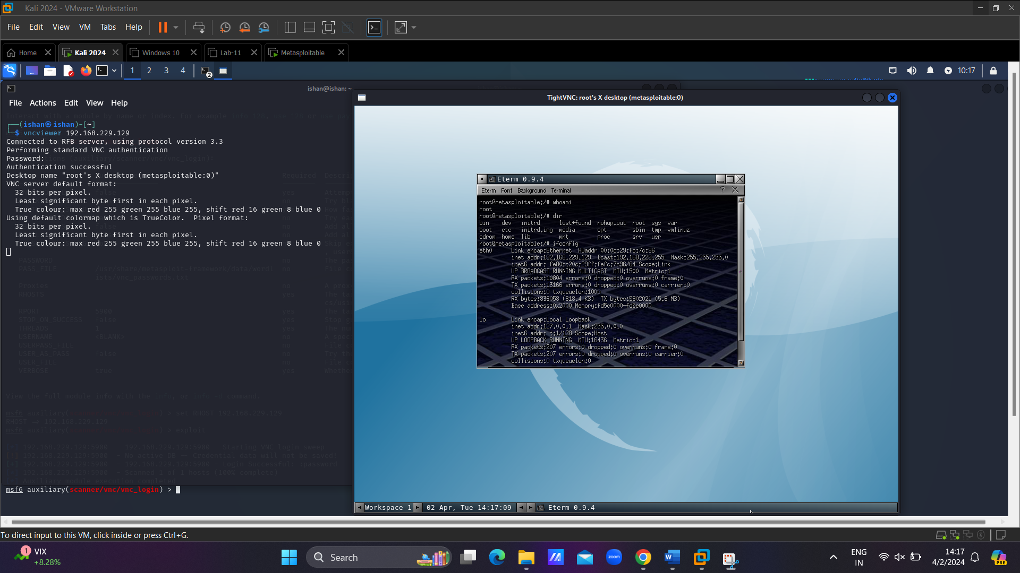
Proof of Concept (PoC)
Exploitation

Slide 8
Proof of Concept (PoC)

Slide 9
2) SSH – Initial Foothold
SSH vulnerabilities typically involve weak authentication (e.g., default or weak passwords), outdated SSH protocol versions, or misconfigurations that allow unauthorized remote access to systems.

Slide 10
Steps to Exploit
Step 1 – Open Metasploit
Step 2 – Search for ssh Payloads
Step 3 – We used ssh_login scanner payload
Step 4 – Set the Parameters
Step 5 - Exploit through bruteforce
Step 6 - Boom!! Got the access

Slide 11
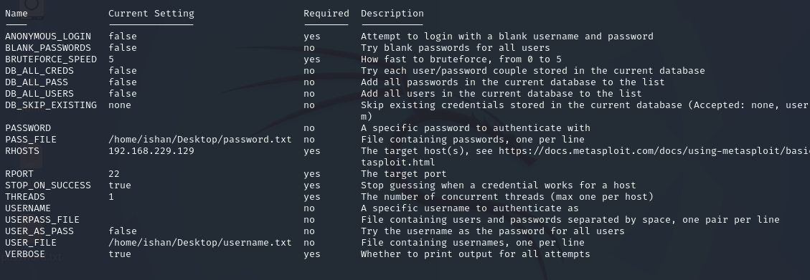
Observation

Slide 12
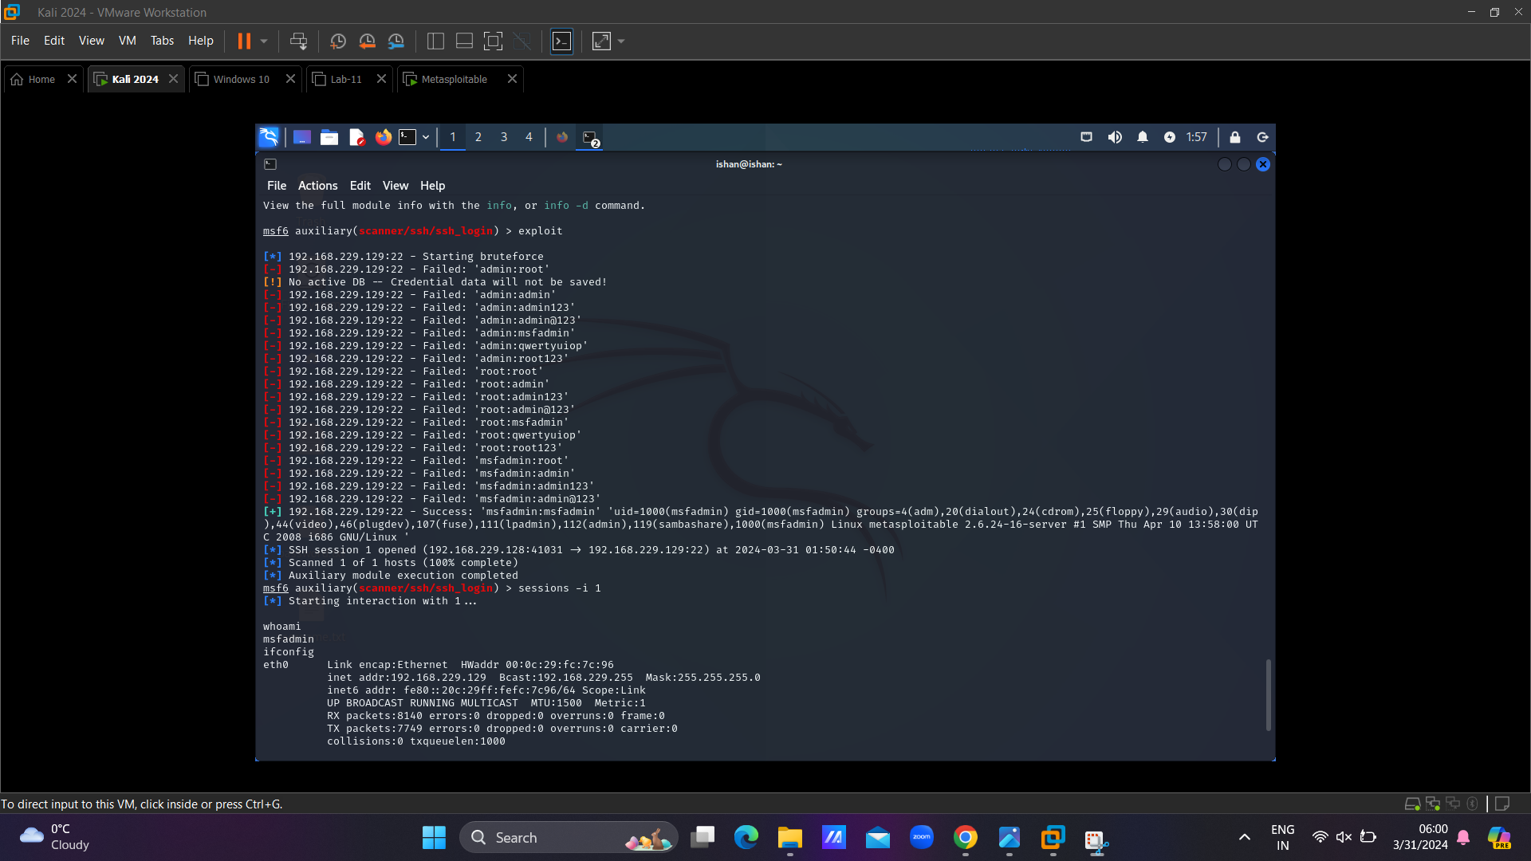
Proof of Concept (PoC)

Slide 13
Proof of Concept (PoC)

Slide 14
Distcc – Privilege Escaation
Privilege escalation refers to the process of gaining higher levels of access or privileges on a system than originally intended by its administrator.
Distcc is a tool commonly used in software development environments to distribute compilation tasks across multiple machines in a network.
Its primary purpose is to speed up compilation times by leveraging the computing power of multiple machines.

Slide 15
Steps to Exploit
Step 1 – Exploit through Metasploit for normal access
Step 2 – To escalate the privileges we need to know which kernel it uses.
Step 3 – Find exploits for the kernel found
Step 4 – Copy the exploit to Apache
Step 5 – Prepare the file, compile it in the low – privilege access and upload it to target machine
Step 6 – Start the listener (netcat)
Step 7 – Run the exploit in low – privilege access
Step 8 – Boom!! You have the root access

Slide 16
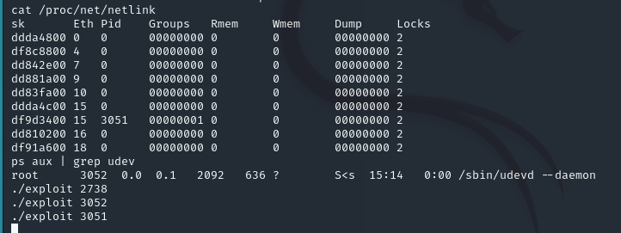
Observation

Slide 17
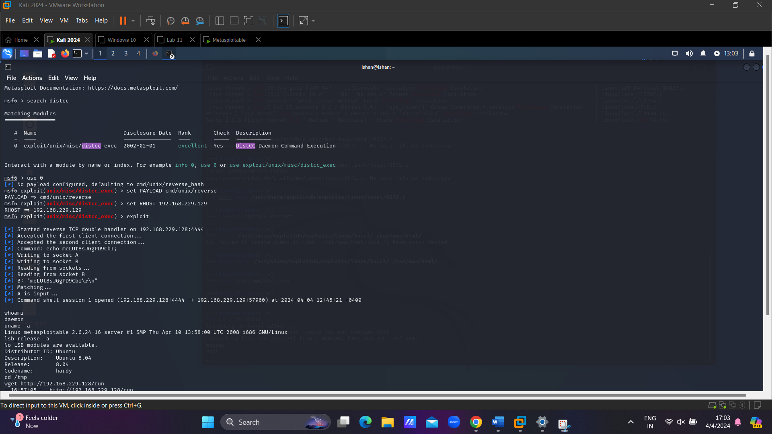
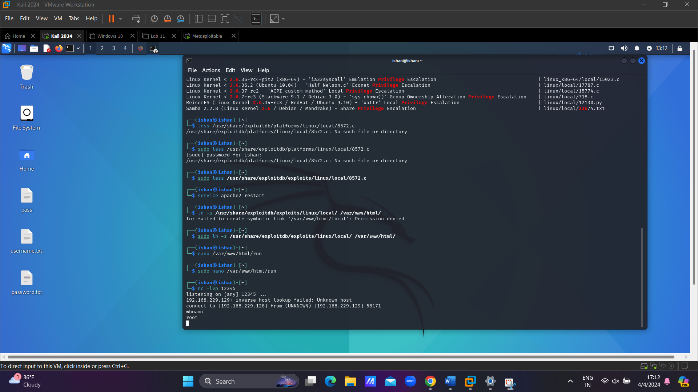
Proof of Concept
Normal Access
Root Access

Slide 18
4) SQL Injection - DVWA
SQL injection is a web security vulnerability that allows an attacker to interfere with the queries that an application makes to its database."
By injecting malicious SQL code into input fields, an attacker can manipulate the database queries to perform unauthorized actions, such as accessing sensitive data or executing arbitrary commands.
Common Payload - ‘ OR ‘1’ = ‘1’ #

Slide 19
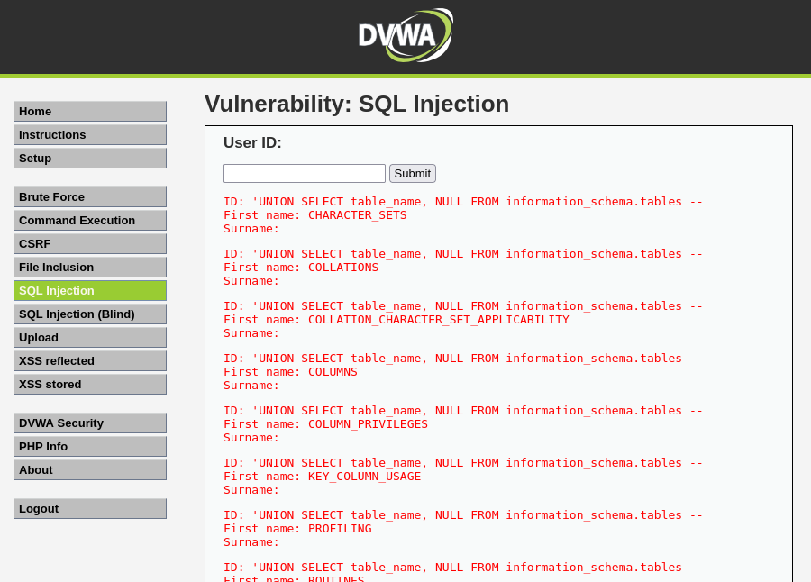
Observation

Slide 20
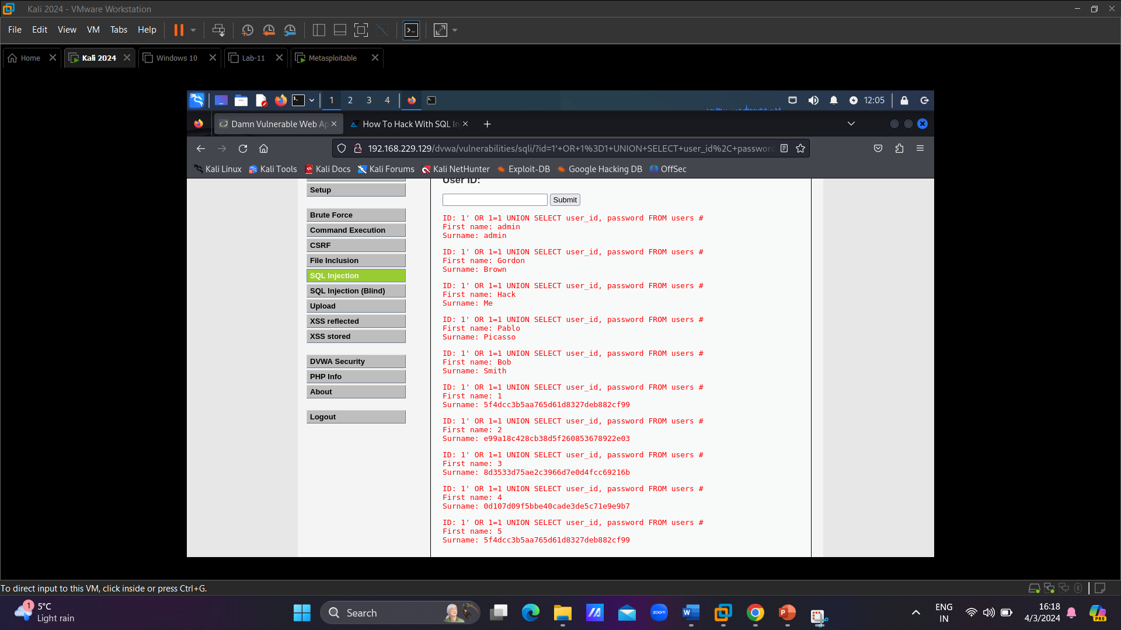
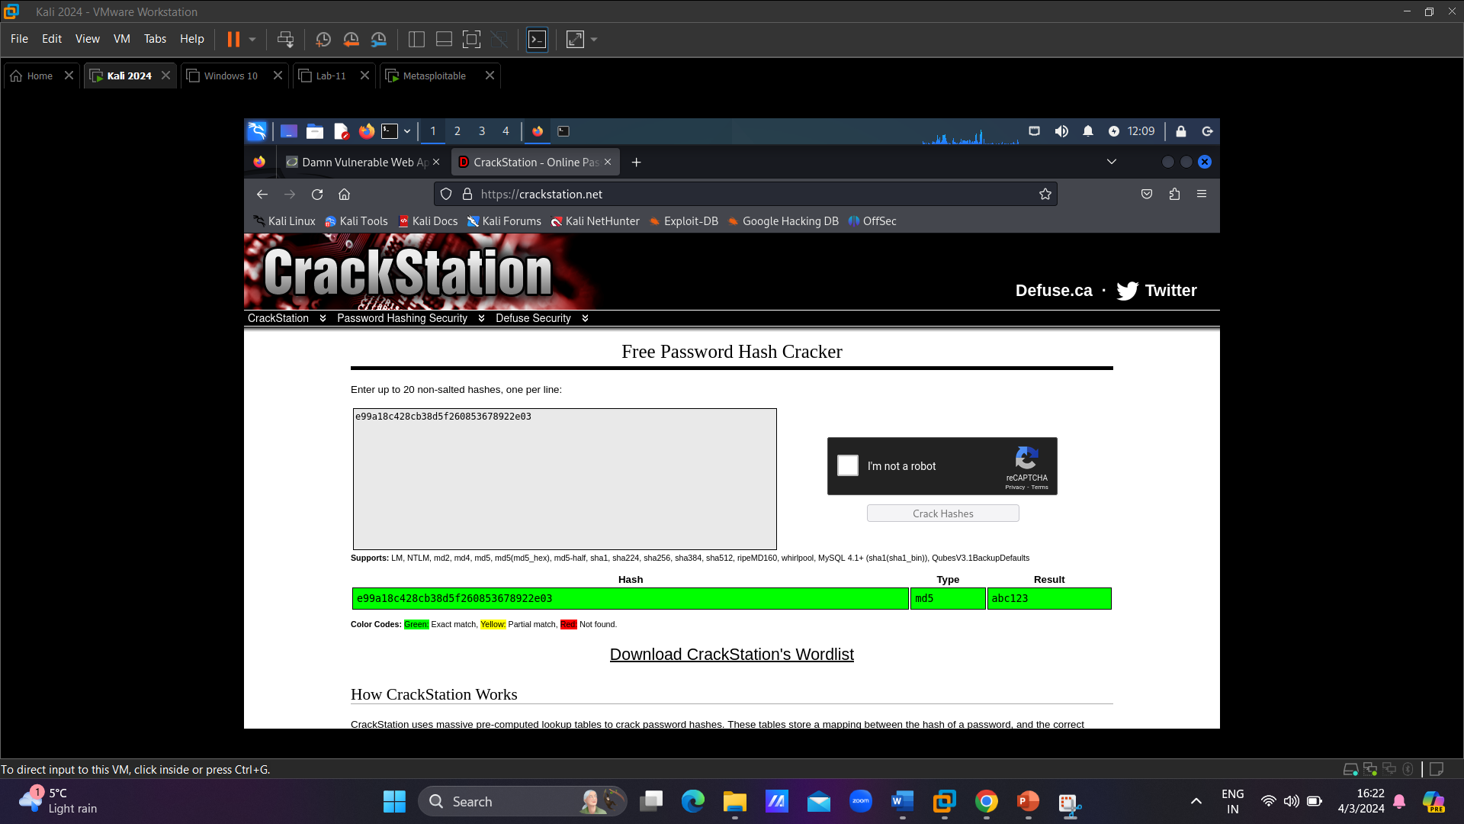
Proof of Concept (PoC)
ID Passwords
Hash to Simple Convertion

Slide 21
5) Cross Site Scripting (XSS) - DVWA
XSS occurs when an attacker injects malicious scripts into web pages viewed by other users.
This vulnerability can have various consequences, from stealing session cookies to defacing websites or redirecting users to malicious sites.
XSS attacks typically involve injecting malicious JavaScript code into input fields or URLs, which are then executed in the context of a victim's browser.
This allows attackers to hijack sessions, steal sensitive data, or perform other malicious actions on behalf of the victim.

Slide 22
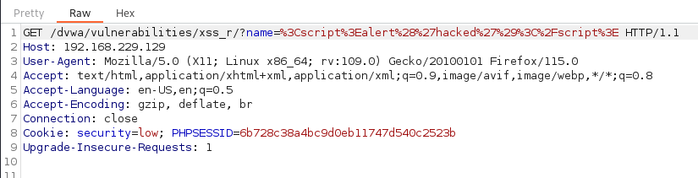
Observations
Payload - <script>alert(‘Hacked’)</script>

Slide 23
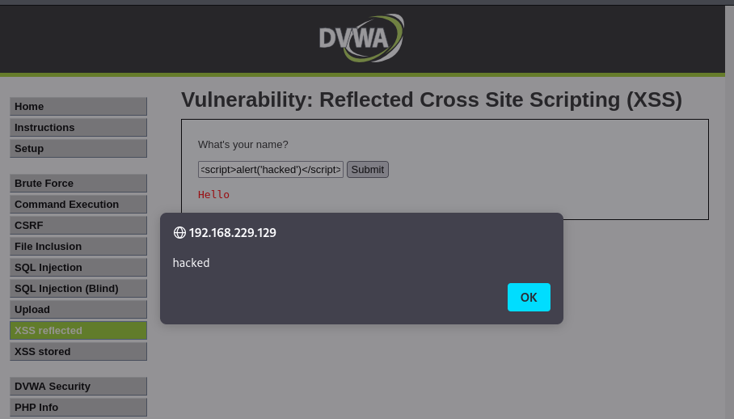
Proof of Concept (PoC)

Slide 24
6) Cross Site Request Forgery (CSRF)
CSRF occurs when an attacker tricks a user into performing unintended actions on a web application where they are authenticated.
This vulnerability can lead to actions such as changing passwords, making unauthorized transactions, or modifying user settings without their consent.
CSRF attacks exploit the trust that a web application has in a user's browser.
An attacker crafts a malicious request and tricks a victim into unknowingly executing it, leveraging the victim's authenticated session with the web application.

Slide 25
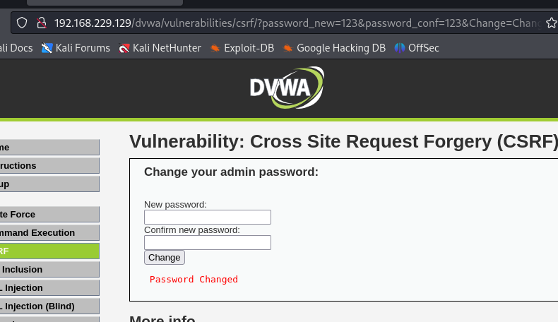
Observation

Slide 26
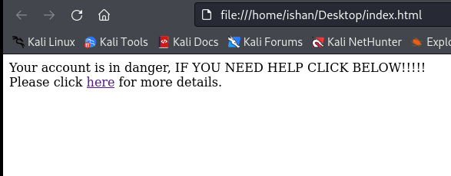
Proof of Concept (PoC)
Lead the user to this malicious html page

Slide 27
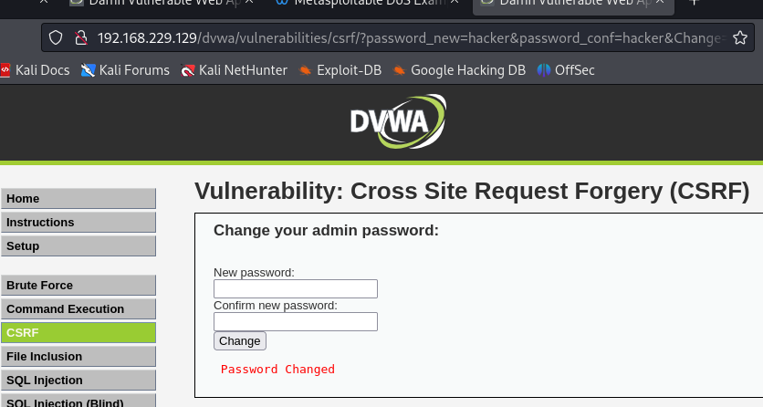
Proof of Concept (PoC)

Slide 28
Any Questions?

Slide 29
Thank you…

